Slide 1
Design & CAD Best Practices
李岱峰
2020.07.22

Slide 2
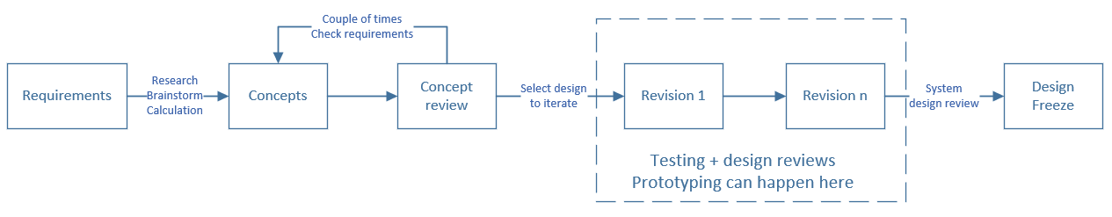
Design
Requirements:
Know Requirements (then prioritize requirements)
Background Research (If exists, don’t redesign it)
System calculation
Component level research
Constantly check system mass and space envelope
Design reviews
ask for help if needed
Notes:
link to good presentation as example for “design requirement”

Slide 3
Collaborating Etiquette
Fully define the position of each part in assembly, unless visualization of motion needed for certain parts
Don’t push parts/assemblies when they are broken, fix what you break before you push
Use part library if available
Don’t release linked parts
Use “Weldment” feature for tube, 80/20, angle, and other structures made from “beam” elements.

Slide 4
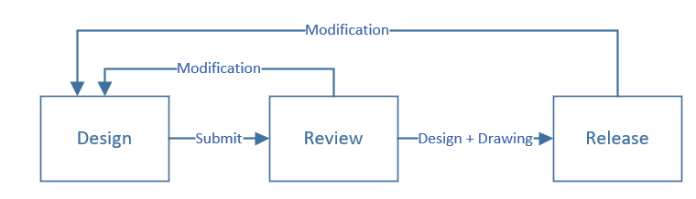
CAD Workflow
Example: SolidWorks PDM
Notes:
Review on drawings before release

Slide 5
Sketches (some are SW specific)
Fully define sketches. All BLACK, no BLUE.
DO NOT use “Fully Define Sketch” button
Use equations, relations, and general variables
Use relation definitions (for example, “=”), or define variables
Dimension rectangles from the edges, not the corner
Make separate features in separate sketch unless it’s master sketch from top-down
Use symmetrical relations
Put origin at a mounting location (or center point)
Use construction lines to help define sketch
3D Sketch - 2D first then having 3D sketch come off of that
Notes:
Baseline dimensioning

Slide 6
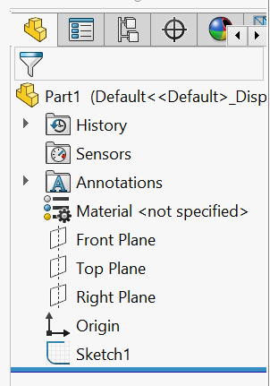
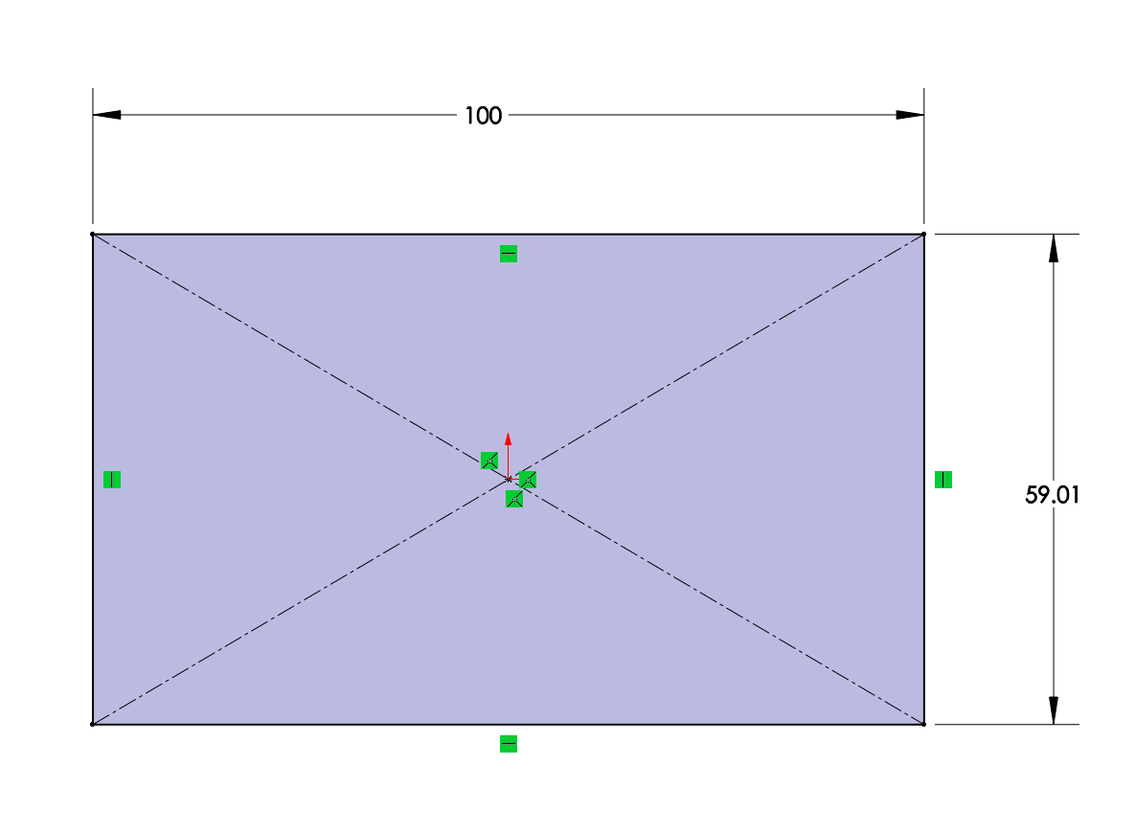
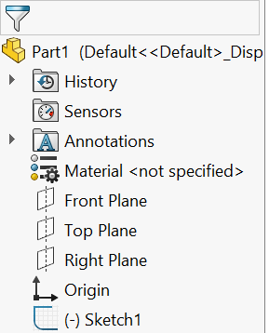
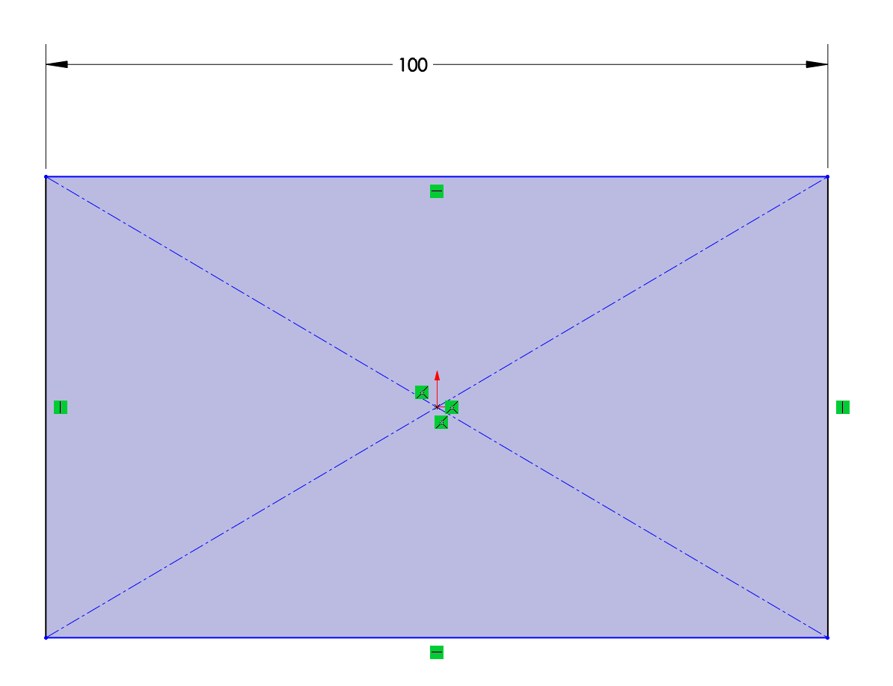
Sketch - Fully Define Sketches

Slide 7
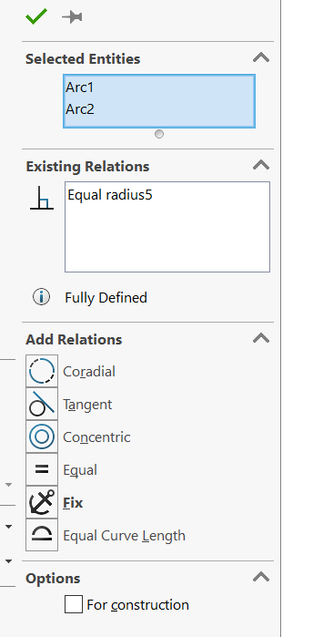
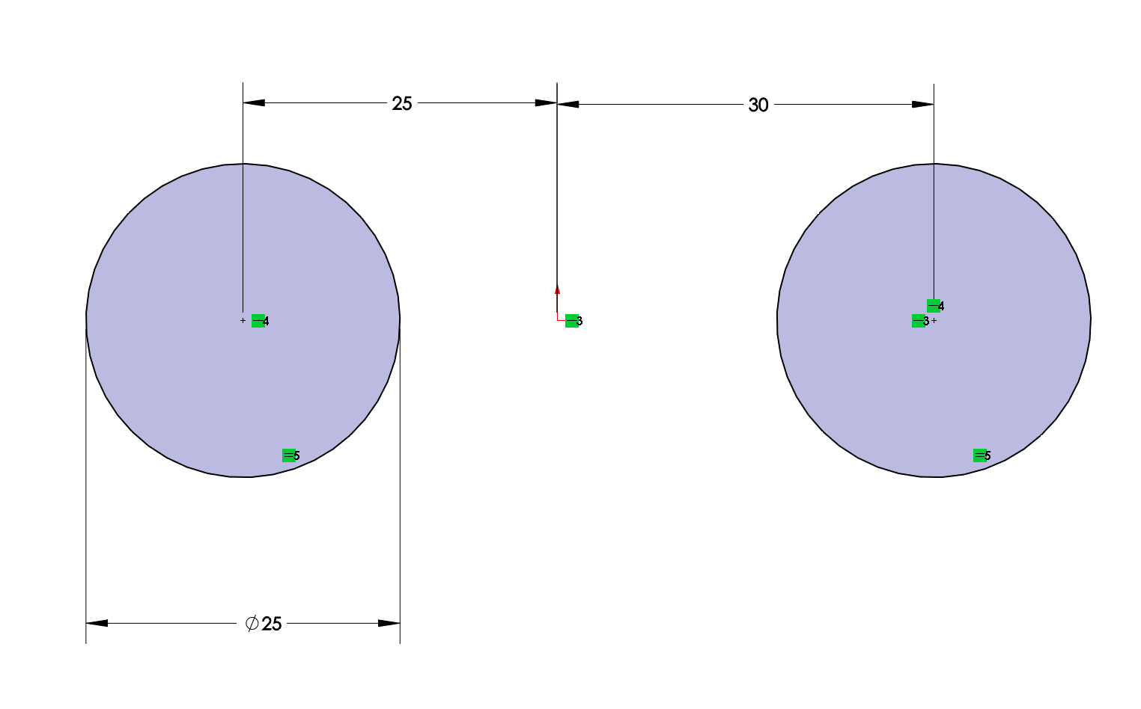
Sketch - Combine Common Dimensions

Slide 8

Sketch - Dimensioning Rectangles
Notes:
Example of why, what’s gonna happen if not

Slide 9
Use Construction Lines
Also:
-Symmetrical Relation
-Origin

Slide 10
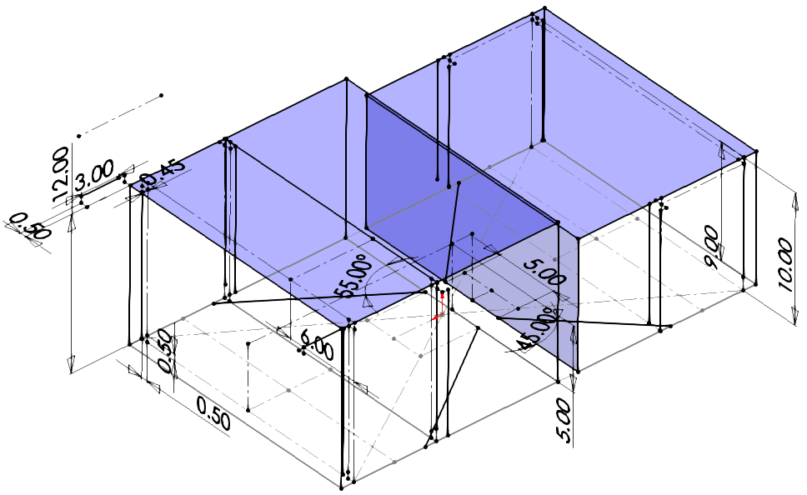
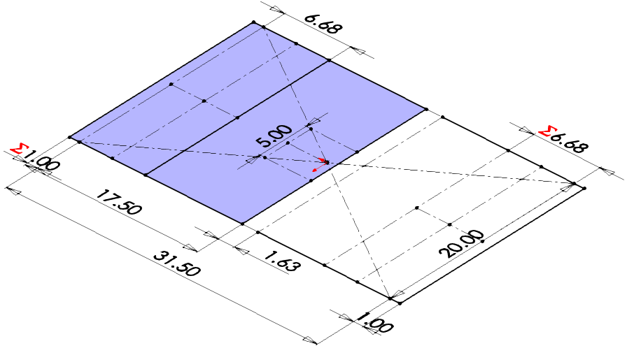
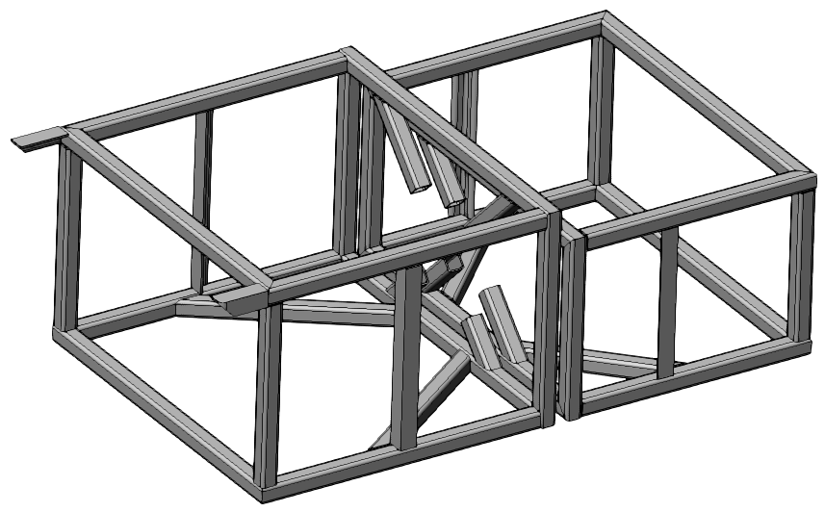
3D Sketch
SubT Frame Example
Initial 2D controlling sketch.
Detailed 3D Sketch based off of 2D Sketch
Weldment Feature Created from Both Feature

Slide 11
Parts
Use symmetry whenever possible
Use configuration when possible (NOT PROGRESS RELATED)
Make features like when it’s being machined (block/cut)
Use design table
Name useful dimensions and features
Especially when those dimensions are referenced
Make several simple features instead of one complicated feature. (More robust and easy to edit)
Use fillet features instead of sketch fillets
Apply cosmetic fillet and chamfer last
Notes:
If slightly different, make it different for assembly as well (use the esymmetrical)
Configuration: for example - waterjet, undersize holes “waterjet config”

Slide 12
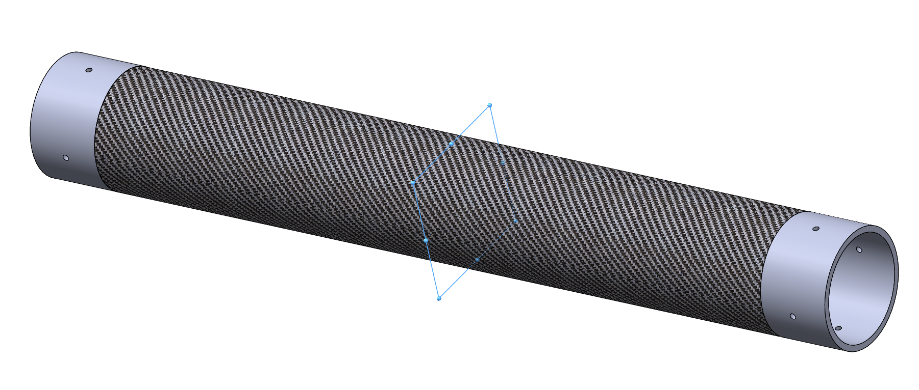
Use Symmetrical Relations

Slide 13
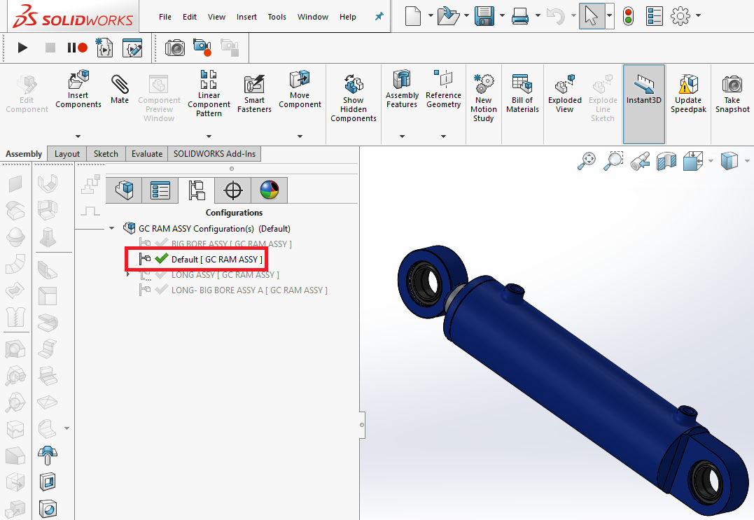
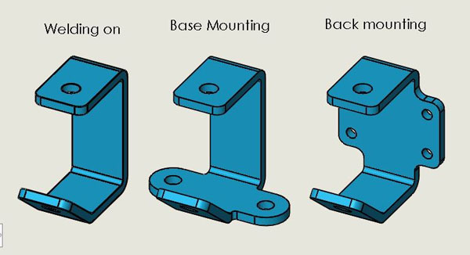
Use Configuration

Slide 14
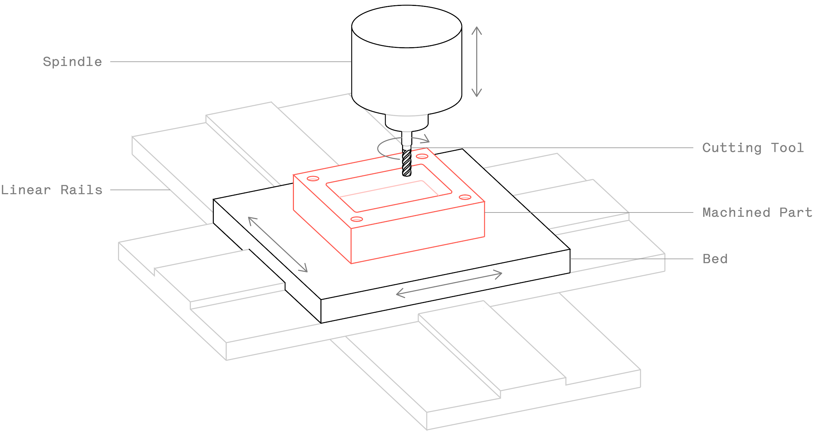
Make features Like Being Machined
Even better, if you dimension it as being machined

Slide 15
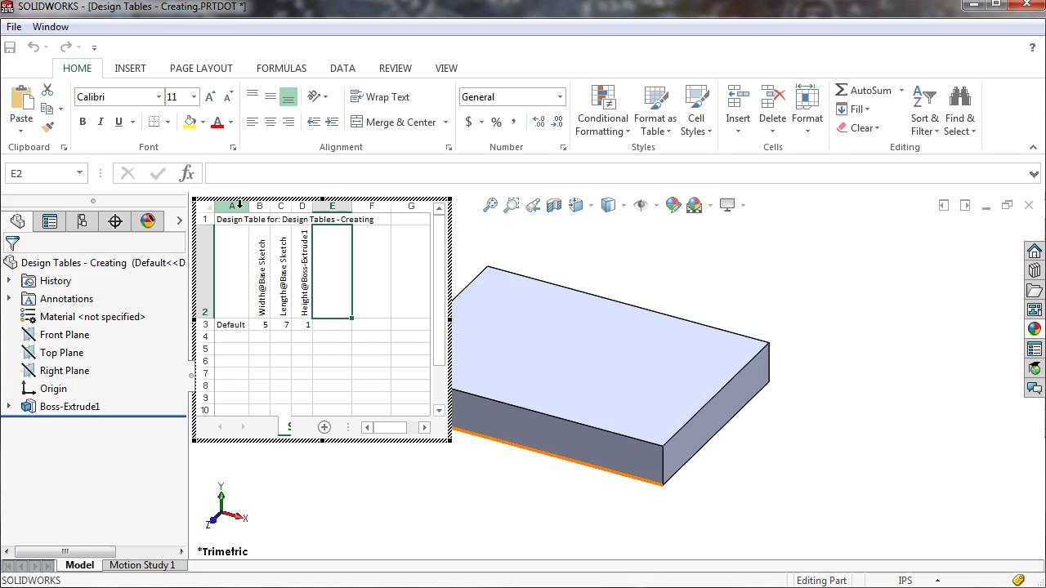
Use Design Table
Notes:
link to where to get the tutorial

Slide 16
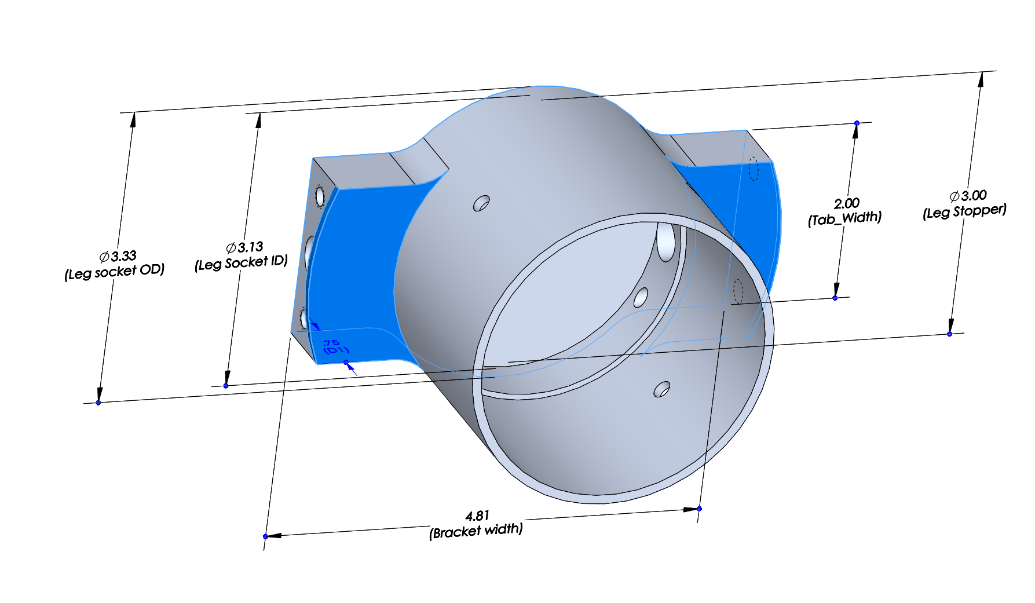
Label Important Dimensions

Slide 17
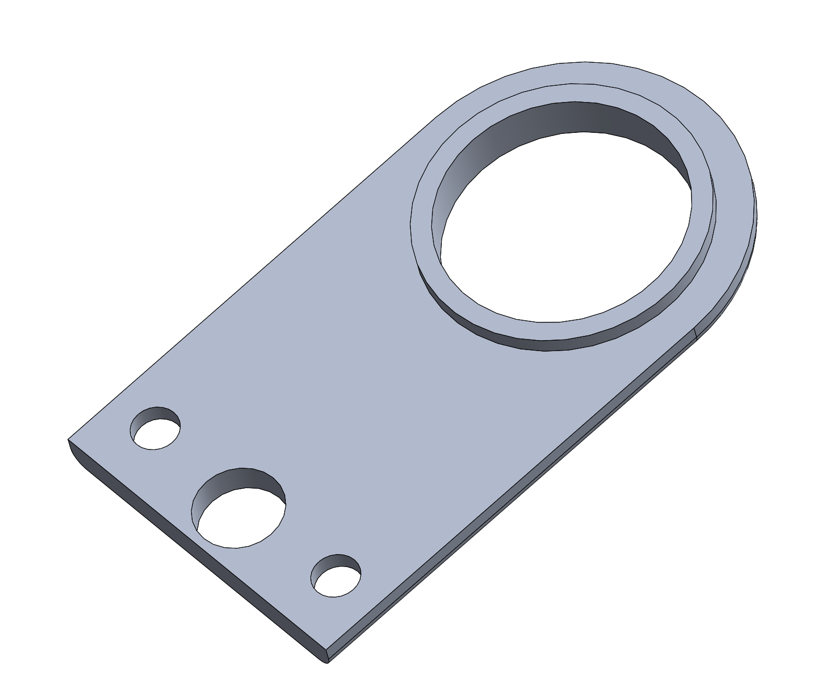
Make Separate Features for Sketches
Notes:
Hole wizard on the corner
Use folder structure

Slide 18
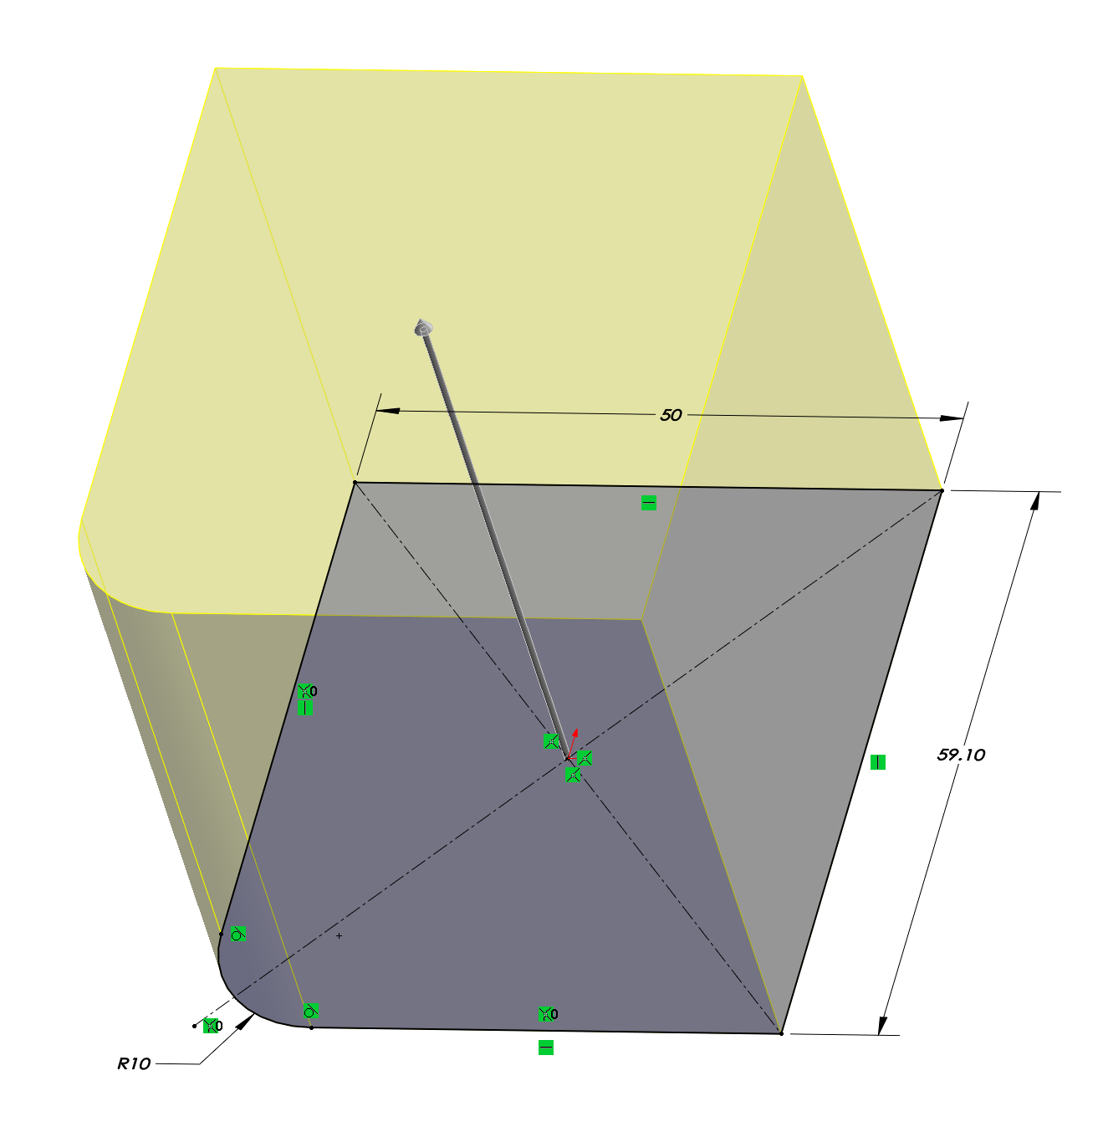
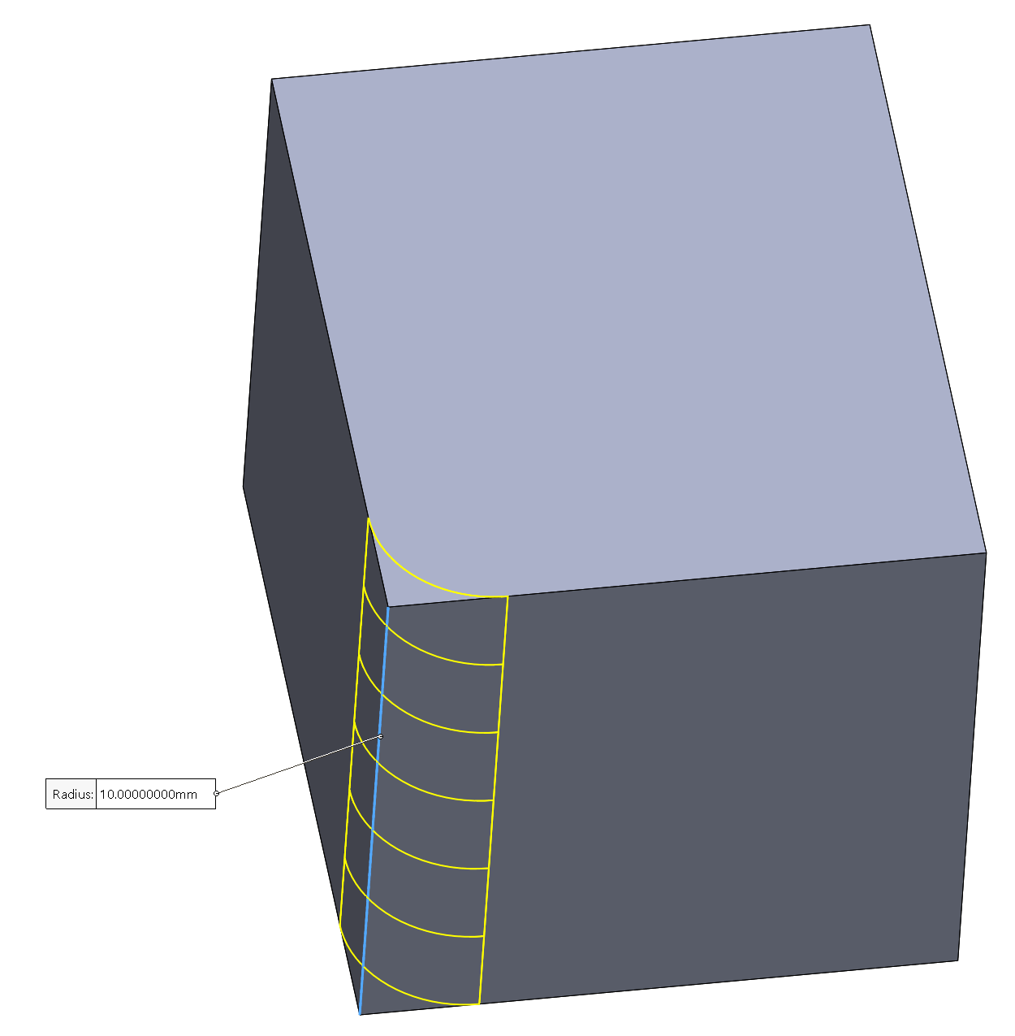
Fillet in Feature Not Sketch if Possible

Slide 19
Imported Components
Suppress threads
When downloading parts, choose the best type available
In order: .sldprt, .sldasm, .igs, .step/stp (AP214), .step (AP203), .stl
Complete feature recognition the first time and save
For modified purchased parts, put all original features in a feature folder to make clear what your changes are
For assembly, save as part if you can
If you have to have an imported assembly, put it in a subfolder
Try to avoid surface models when possible
Clean up surfaces with the “Delete and Patch” tool
Override mass property with catalog listed mass
Notes:
explain why for the order the download type
“dissolve part” - Ralph solidwork 2018 for igs

Slide 20
Assembly
Origin plane mates (especially first part)
If possible, mate all components to one or two fixed references
Long chains of components take longer to solve and more likely to get errors.
Do not create loops for mates
Fully define the position of each part in assembly, unless visualization of motion needed for certain parts
Option: use mechanical mates
Patterns, not multiple same parts if possible (greatly reduce computing power needed)
Lock rotation on cylindrical mate

Slide 21
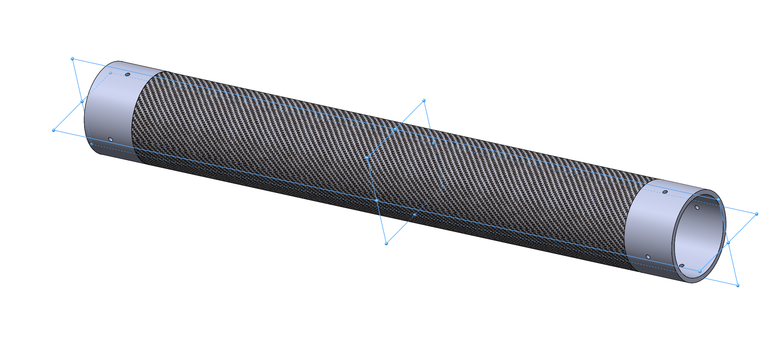
Put Origin as Mount Location
Notes:
Float first, and re-mate it

Slide 22
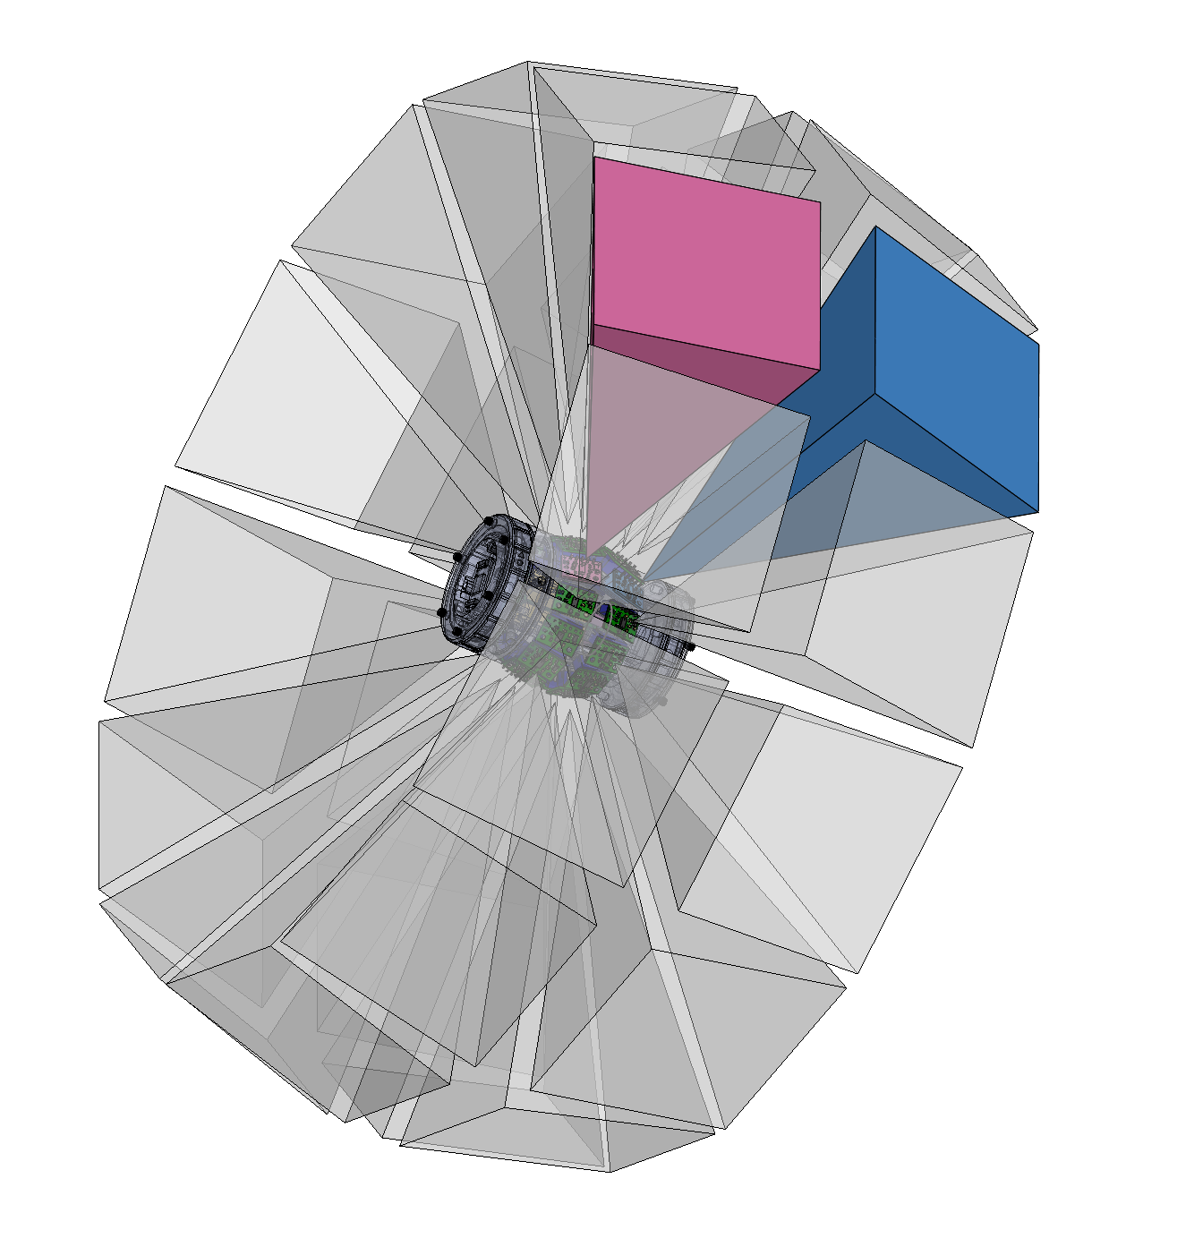
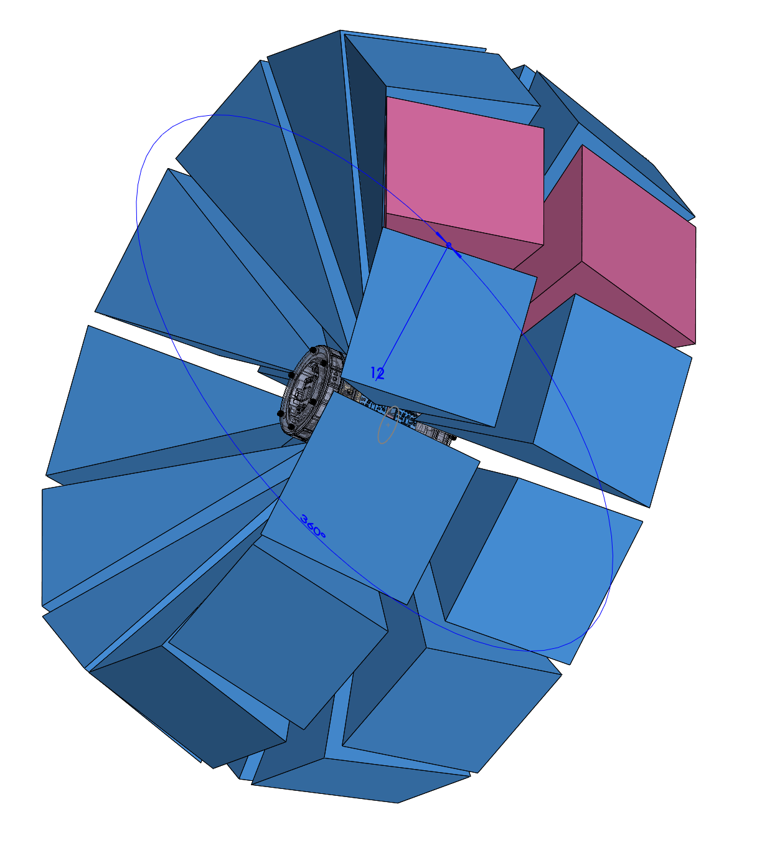
Use Component Patterns
In addition, use the magic combo:
hole wizard
+
Pattern driven component pattern

Slide 23
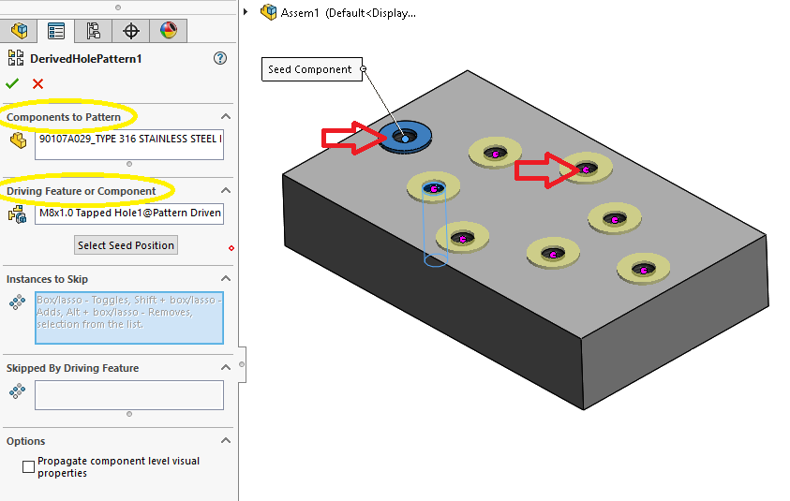
Pattern Driven Component Pattern

Slide 24
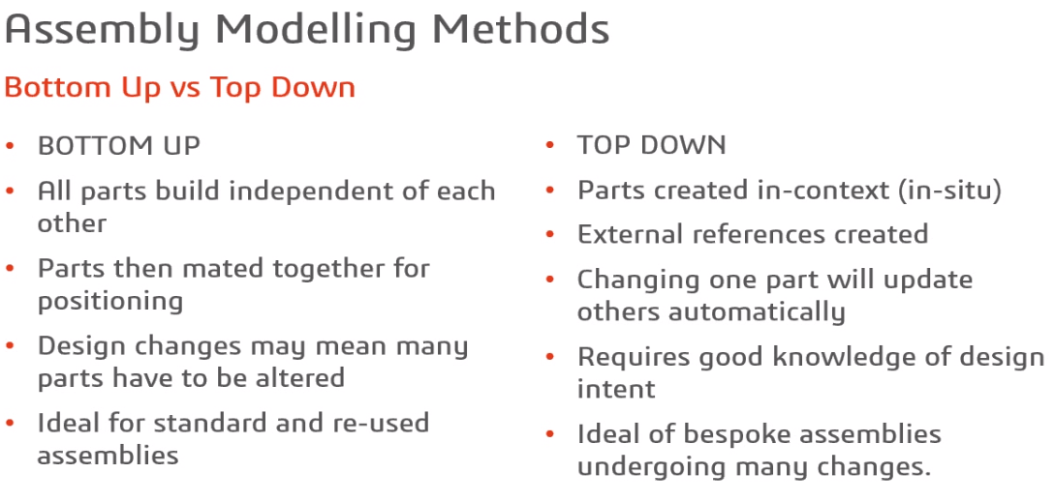
https://www.solidsolutions.co.uk/solidworks/tutorial-videos/top-down-modelling-best-practice.aspx

Slide 25
Bottom Up
Model parts about the origin
Mate with planes/references instead of features
Don’t link parts

Slide 26
Top Down
Name key dimensions on master model
Create moveable blocks

Slide 27
Reference Links
● http://help.solidworks.com/2018/English/SolidWorks/sldworks/c_Best_Practices_for_Mates_SWassy.htm?verRedirect=1
● https://blog.alignex.com/10-large-assembly-best-practices-in-solidworks
● https://forum.solidworks.com/thread/183132
● https://petercad.com/category/solidworks-best-practices/
● https://www.solidsolutions.co.uk/solidworks/tutorial-videos/top-down-modelling-best-practice.aspx

